Slide 1
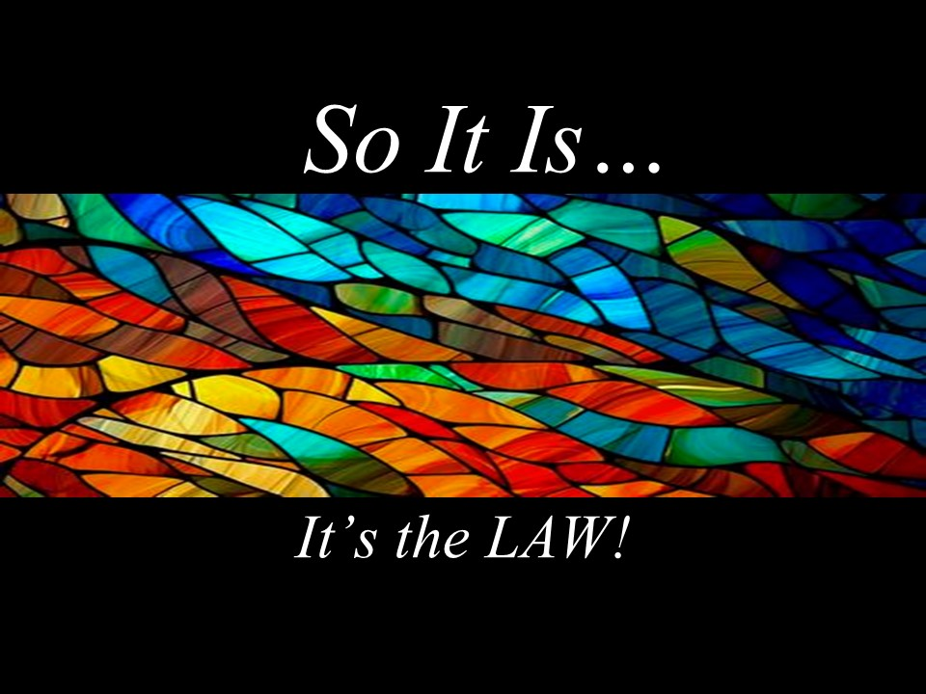

Slide 2
The Law
That which is like unto itself is drawn.
Esther Hicks
Thoughts held in mind produce in like-kind.
Unity
What the mind can conceive and believe,
it can achieve.
Napoleon Hill

Slide 4
The Law in Scripture
"Give and it is given back to you"
"Let it be done to you as you believe"
"You will decide on a matter & it will be established for you."
"As you think in your heart, so you will be."
"You will be forgiven as you forgive others."
"Do to others as you would have them do to you"
"All who take the sword will perish by the sword."
“For with the judgment you make you will be judged”
"Believe that what you say will come to pass, it will
be done for you."

Slide 6
Each of us is literally what we think…our character being the complete sum of all our thoughts. We do not attract that which we want but that which we are.
James Allen – As A Man Thinketh
Any idea you have which is emotionalized and
felt as true enters into your subconscious mind
and comes to pass.
Joseph Murphy – How To Use The Laws of Mind

Slide 8
You’re familiar with the command, ‘Do not murder.’ I’m telling you that anyone who is so much as angry with a
brother or sister is guilty of murder.
Matt. 5.21
It is the law of Spirit that we must
be that which we would draw to us.
Charles Fillmore
You simply cannot offer enough action to compensate for the contradictory energy of your Being. The Law of Attraction is responding to your vibration, not your action.
Esther Hicks

Slide 10
Ask in faith, never doubting, for the one who doubts
is like a wave of the sea, driven and tossed by the wind; for the doubter, being double-minded and unstable in every way, must not expect to receive anything from the Lord.
James 1.6-8

Slide 12
Realization is a conviction that a person gets when he has persistently concentrated his attention on an ideal until he feels assured of the fulfillment of the ideal. Realization means that the idea has nucleated a certain amount of thought substance.
Charles Fillmore

Slide 14
Working with the Law
Notice signals from your body, emotions.
Allow the low energy feelings to be felt.
Ask what it’s telling you.
What do I prefer instead?
How does Spirit fulfill that desire?
How does it feel to live from that?

Slide 16
Stand on the brink of what is coming, feeling eager,
optimistic anticipation – with no feeling of impatience,
doubt, or unworthiness hindering the receiving of it.
That is the optimal creative vantage point.
Esther Hicks

Slide 18

I create my life experience through my thoughts, feelings and beliefs.

