Slide 1


Slide 2
Our Father in heaven, hallowed be your name.
Matt. 6.9
Your kingdom come, your will be done,
on earth as it is in heaven.
Matt. 6.10

Slide 4
You do not have because you do not ask.
You ask and do not receive because
you ask wrongly.
James 4.2

Slide 6
Dear God, please give me $1M…Amen
Dear God, please, please, please give me $1M
Dear God, I really need $1M
Dear God, I know I don’t deserve it but
if I don’t get $1M…
Dear God, I don’t have it. Others have it, why not me? I’ll make you a deal…
Dear God, why won’t you give it to me? Are you even there? Is anybody listening?
God never answers my prayers.

Slide 8
Man never indulges in his animal nature without having a reaction of discomfort.
Charles Fillmore – Keep a True Lent

Slide 10
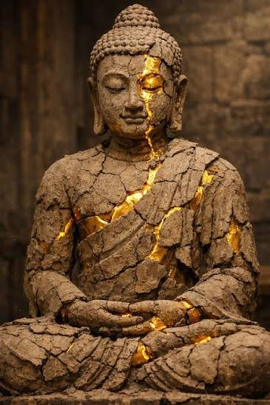

Slide 12
The Light shines in the darkness
and the darkness did not comprehend it.
John 1.5

Slide 14
Prayer is not asking for things, it is the lifting of consciousness to the place where these things are.
Sue Sikking
Do not supplicate or beg God for what you need but get still and think about the inexhaustible resources of infinite Mind, its presence in all its fullness,
and its constant readiness to manifest itself.
Charles Fillmore
Our mind must be steady in our conviction that our life is some part of God and the spirit is incarnated in us. Ernest Holmes

Slide 16
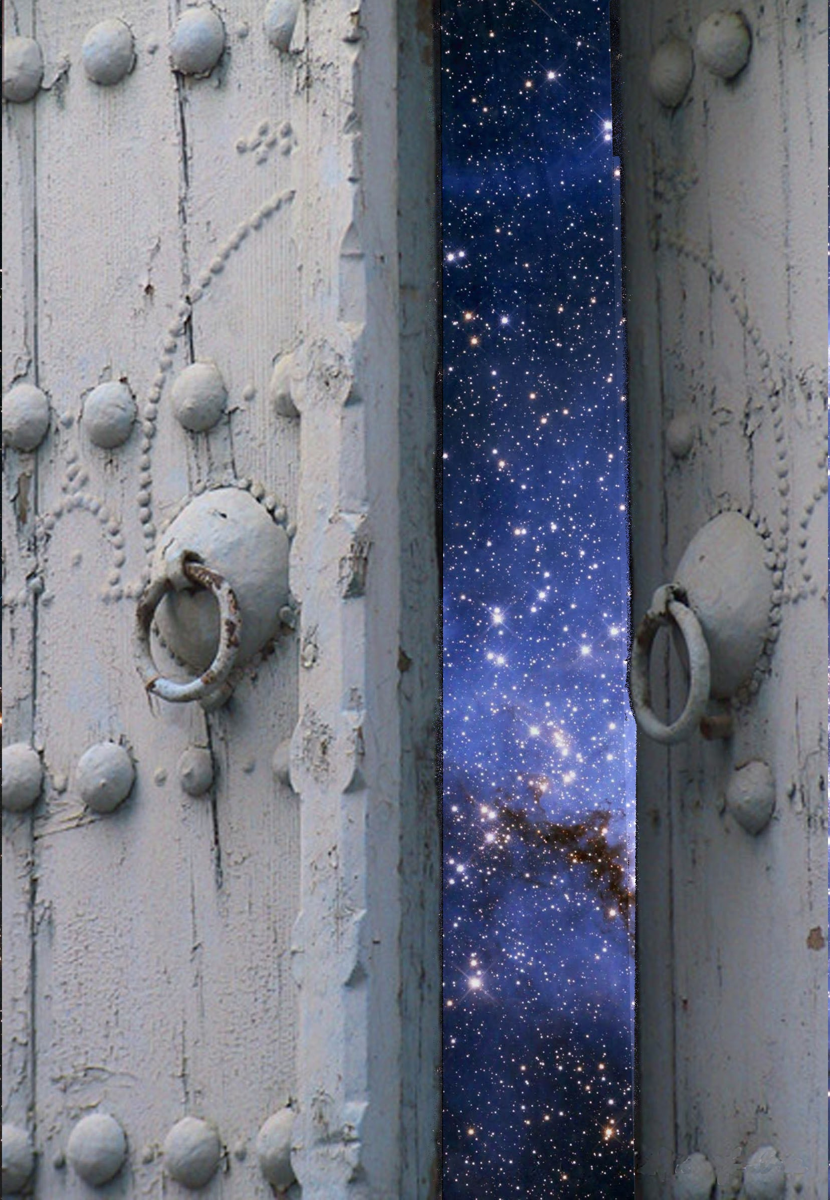
As there is no screen or ceiling
between our heads and the infinite heavens,
so there is no bar or
wall in the soul,
where man, the effect, ceases,
and God, the cause, begins.
The walls are taken away.
We lie open on one side
to the deeps of
spiritual nature,
to the attributes of God.
Ralph Waldo Emerson

Slide 18
I lie open
on one side,
to the deeps of spiritual nature,
to the attributes of God.

