Slide 1
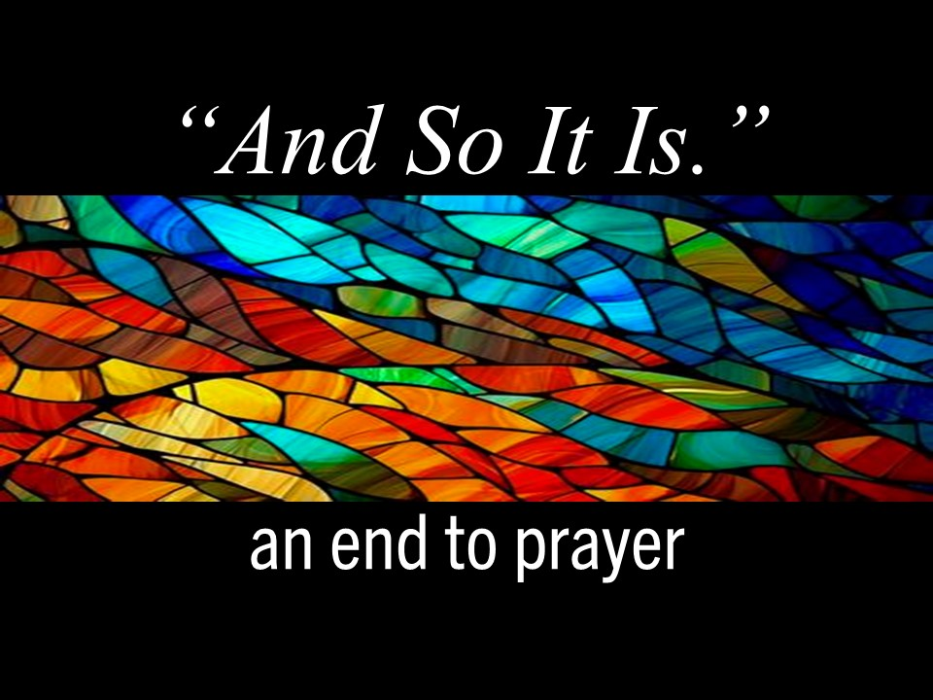

Slide 2
Americans who attend church
1960 > 49%
2024 > 26%
Americans who pray daily
2007 > 58%
2026 > 44%
Age 55+ > 54%
Age 18-24 > 27%
Americans who no longer identify with childhood religion…35%
Americans who see themselves as spiritual but not religious…33%
Americans who believe they
have a soul or spirit … 86%

Slide 4
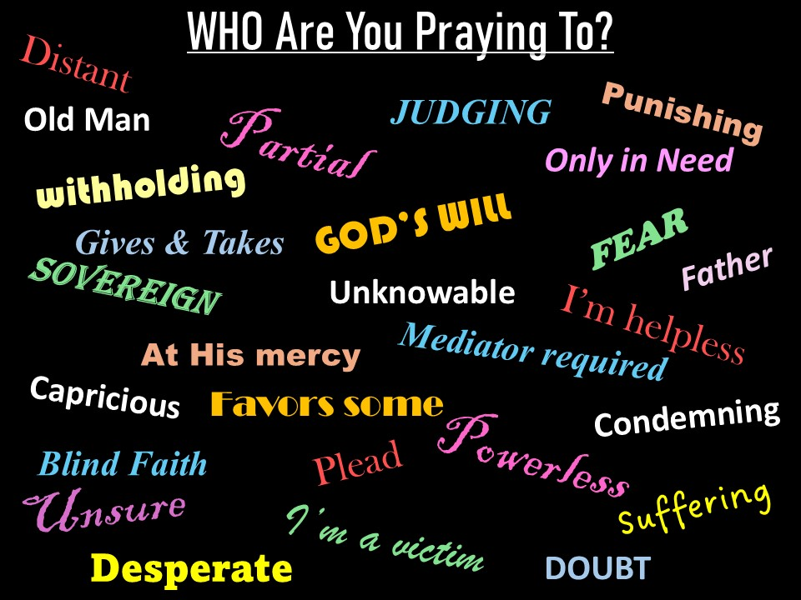

Slide 6
Prayer is a bridge between
our human experience and
the Divine Presence within.

Slide 8
God is Spirit, sheer being itself. Those who worship him must do it out of their
very being, their spirits, their true selves.
John 4.24

Slide 9
Do I not fill heaven and earth, says the Lord.
Jer. 23.24
There are varieties of activities, but it is the
same God who activates all of them in everyone.
1 Cor. 12.6
For in him we live and move and have our being
Acts 17.28

Slide 11
There is but one Mind, and that Mind cannot be separated or divided. It is absolute and all its manifestations are in essence like itself. The individual mind is a state of consciousness in the one Mind…
the mind of humankind is limitless.
Charles Fillmore – Revealing Word

Slide 13
You open your hand, satisfying the
desire of every living thing.
Psalm 145.16
And God is able to provide you
with every blessing in abundance.
2 Cor. 9.8
It is your Father’s good pleasure
to give you the kingdom.
Luke 12.32

Slide 15
God does not need to be served by human hands
as if he needed anything, because he
gives everyone life, breath, and everything else.
Acts 17.24-25

Slide 17
An Act of Worship…
Maintaining a conscious awareness
of God’s Truth in the present moment.
Feeling the presence of God as LOVE
and sharing love with others.
Celebrating the Divine in all beings.

Slide 19
Before they call I will answer,
while they are yet speaking I will hear.
Is. 65.24

Slide 21
When we pray it is the Mind of God
seeking to fulfill itself as us.
Richard & Mary Alice Jafolla- Quest for Prayer
God can only do for us
what God can do through us.
Eric Butterworth – Discover the Power Within You

Slide 23
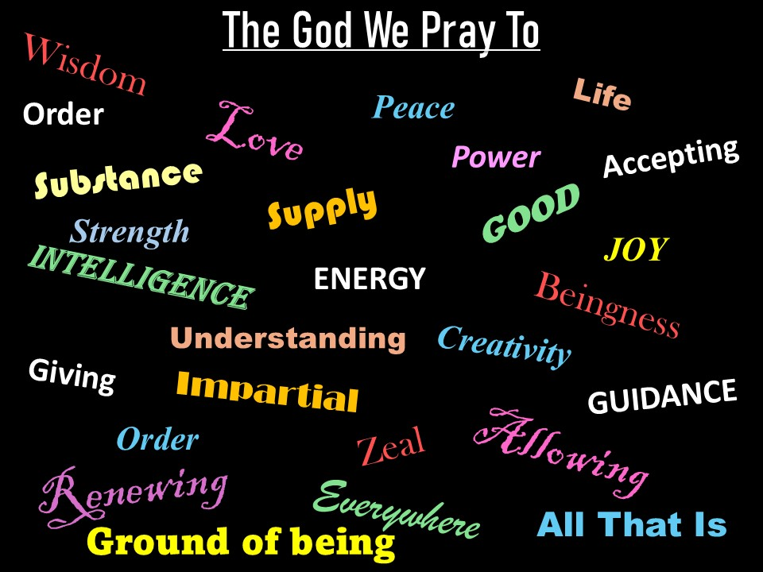

Slide 25
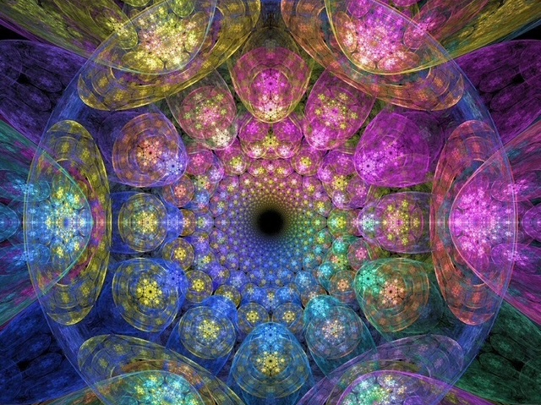
Divine Love,
everywhere present
provides my every need.

