Slide 1
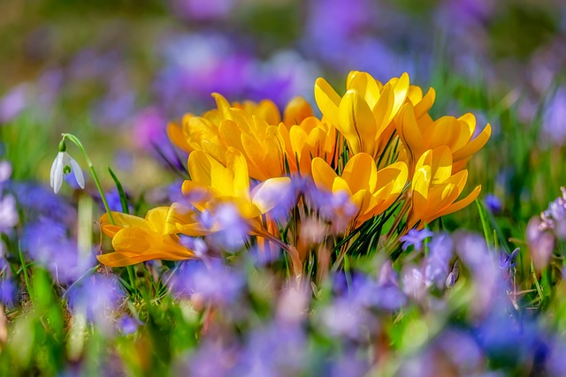
Notes:
Beauty Slide

Slide 2

Bringing Heaven Down
by Jessica Witmer
4x:
We are SINGING a brand new song
We LIFTING up a sound
We bringing heaven down
CHORUS:
Holy, holy, holy– everyone is holy
Everywhere I look, I see the glory, glory!
2x:
2x:
We are BEING THE LIGHT of God
We SHINING like the stars
We bringing heaven down
(REPEAT CHORUS)
We are SINGING…
We are BEING…
(REPEAT CHORUS)

Slide 3

AS I BELIEVE
Words and Music by Kim-Char Meredith & Darlyne Cain
© Kim-Char Music (BMI) & Darlyne Cain Music (BMI)
Spirit withholds nothing from me
Spirit withholds nothing from me
Spirit withholds nothing from me
It is done as I believe!
I declare JOY - Joy like a fountain
I declare PEACE - Peace like a river
I declare FAITH - Faith to move mountains
It is done as I believe!

Slide 4
Notes:
Beauty Slide

Slide 5
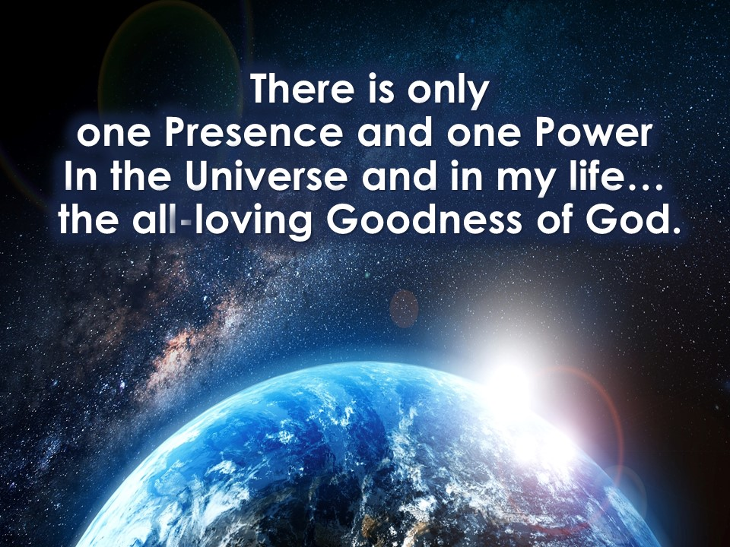

Slide 6
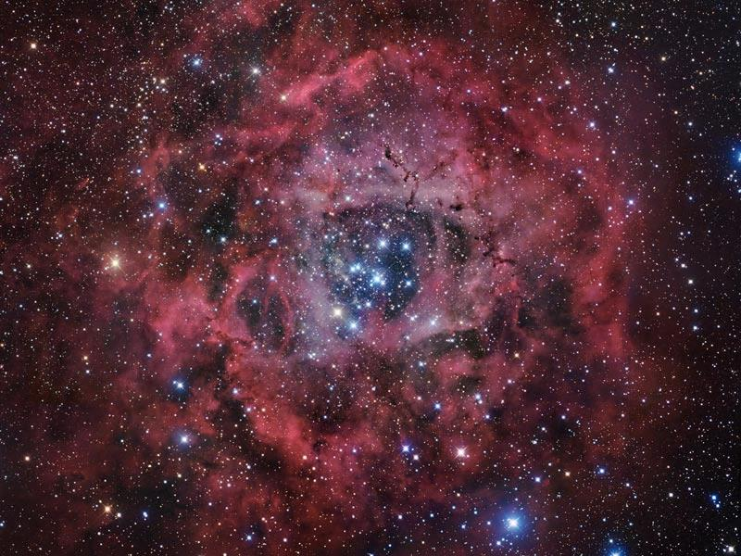
Be Still and Know
Words & Music by Kim-Char Meredith (BMI)
In the silence is the answer
In the silence is all I’m after
In the Presence is the answer
In the Presence is all I’m after
I’m not waiting on Divine; Divine is always here…
I am waiting on my heart and mind
to be open, to be clear…
Be still (be still), be still (be still) and know
Be still (be still), be still (be still) my soul

Slide 7
Notes:
Beauty Slide

Slide 8


Slide 9
I will give you the keys of the kingdom of heaven, and whatever you bind on earth shall be bound in heaven, and whatever you loose on earth shall be loosed in heaven.
Matt. 16.19

Slide 11
A thief is only there to steal and kill
and destroy. I came so they can have real and eternal life, more and better life than they ever dreamed of.
John 10.10
It is the spirit that gives life; the flesh
is useless.
John 6.63

Slide 13
If you do not doubt in your heart, but believe that what you say will come to pass, it will be done for you.
Mark 11.24

Slide 14
CREATE PRO-ACTIVELY with an OPEN MIND
- If money were no object…
- If I could do anything I want…
- If I couldn’t fail …
- I feel most alive when…
- I can’t get enough of …
- Time flies when I am …

Slide 16
OVERWHELMED BY THE NEGATIVE?
- My heart hurts when…
- My greatest challenge is…
- I wish I could have done that differently…
- The main obstacle keeping my good from me is…
- The regret I think of most often is…
What would I prefer instead?

Slide 18
THE TRUTH BEHIND WONDERFUL THINGS
1. I am a unique expression of the One Presence and One Power. I am eternal and infinite. There’s no separation between my mind and Divine Mind..
2. Creating something new does not depend on being smart or having lots of head knowledge. There’s no limit to my ability to create.
3. Whether I am 90 or 9, love, faith, confidence, joy, laughter and inspiration never grow old.
4. There are infinite ideas waiting in Potential. Nothing and no one can separate me from my good.
5. God’s will is always good and never to punish or withhold. The Universe is for me, not against me.
6. We came here to experience life more abundantly. There’s infinite substance available to all.

Slide 19
THE TRUTH BEHIND WONDERFUL THINGS
7. The Law of Mind Action is always responding to my thoughts, feelings & beliefs. I am creating my destiny whether I’m aware or not.
8. I cannot fail or do it wrong. Past mistakes have no power.
9. We haven’t begun to tap into the infinite creative thinking of Divine Mind – all things are possible.
10. Nothing is too big or too good for me to experience. There are no limits unless I set them.
11. It’s done as I believe. I do not fear; fear is a process of thought and thought is creative.
12. Divine Mind is infinite, always available, always seeking to express itself in new ways through me.

Slide 21
TOOLS FOR CREATING SOMETHING NEW
- Choosing between two thoughts? Which thought feels better?
- Don’t let HOW hold you back.
- What’s your motive?
- What do you prefer instead?
- Only choose a thought if it’s one you’d like to experience.
- If there were no limitations, I would…
- Wouldn’t it be nice if…?
- Spend time daily in the Silence.
- Keep your energy high. Look for the good. Do what feels good.

Slide 23

Notes:
MEDITATION

Slide 24
Notes:
Beauty Slide

Slide 25


HOW TO DONATE…
ONLINE at
UnityInNaperville.org
BY MAIL at
PO BOX 9733
Naperville, IL 60567

Slide 26
It’s Showing Up
Written by Kim-Char Meredith
The mystery and magic of life – the world I live in, I design!
What I imagine comes alive;
It’s showing up – right here, before my very eyes…
CHORUS:
I think it, feel it, taste it, breathe it
I hear it, see it – my good, I receive it!
It’s showing up right here, before my very eyes.
I tune in and turn to my Light – Spirit and passion are my guides
What I imagine comes alive;
It’s showing up – right here, before my very eyes… (CHORUS)
When its time to play and explore, here is where creation starts:
I lift my brush and begin by painting an open heart - then I…
Think it, feel it, taste it, breathe it, I hear it, see it – my good, I receive it!
I think it, feel it, taste it, breathe it, I hear it, see it – my good, I receive it!
It’s showing up right here, before my very…
Before my very… before my very eyes!
Notes:
Offering Song - It’s Showing Up

Slide 27
Divine Love, through me,
blesses and multiplies
all that I have, all that I give,
and all that I receive,
and I am grateful.
Notes:
MAILING ADDRESS

Slide 28
Notes:
Beauty Slide

Slide 29

Welcome
Newcomers!
  Questions? Email:
  admin@UnityInNaperville.org
Please complete the Orange
Registration Card at the Welcome Table
or sign up for weekly Enews at
UnityInNaperville.org

Slide 30

Today!

Slide 31
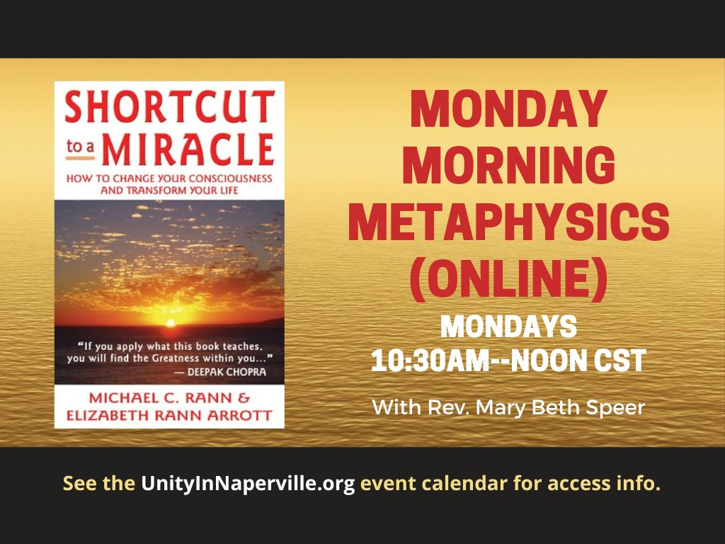

Slide 32

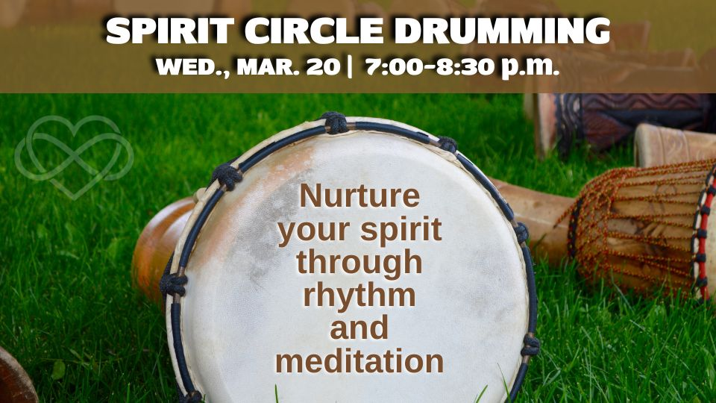

Slide 33

Sisters in Spirit
Book Club
Online
TUE MAR 18th
7pm-8:30pm
For more info contact
Admin@UnityInNaperville
Zoom link on calendar at
UnityInNaperville.org

Slide 34


Slide 35

What’s Your PURSE-onality?
Unlock the Secret of Your Purse-onal Style
with Humorist and Purseologist, Deb DiSandro
SAT APR. 5
10a – Noon
Laugh and learn to:
Lighten the load in your purse and in your life
Discover the power of your unique Purse-onality
Get along with any Purse-onality
$30 in advance
$40 at the door
50/50 Raffle!
Raffle tickets $5ea
Tickets at the Info Table & online at UnityInNaperville.org.
Proceeds go to Unity in Naperville. Thank you for your support!

Slide 36

Volunteer Opportunity!
WED MAR 26 at 11:15-1:15pm
Please arrive promptly at 11:15 am.
Location: Feed My Starving Children,
555 Exchange Court, Aurora, IL
Sign up by Mar 19 in the cafe or email
Admin@UnityInNaperville.org

Slide 37
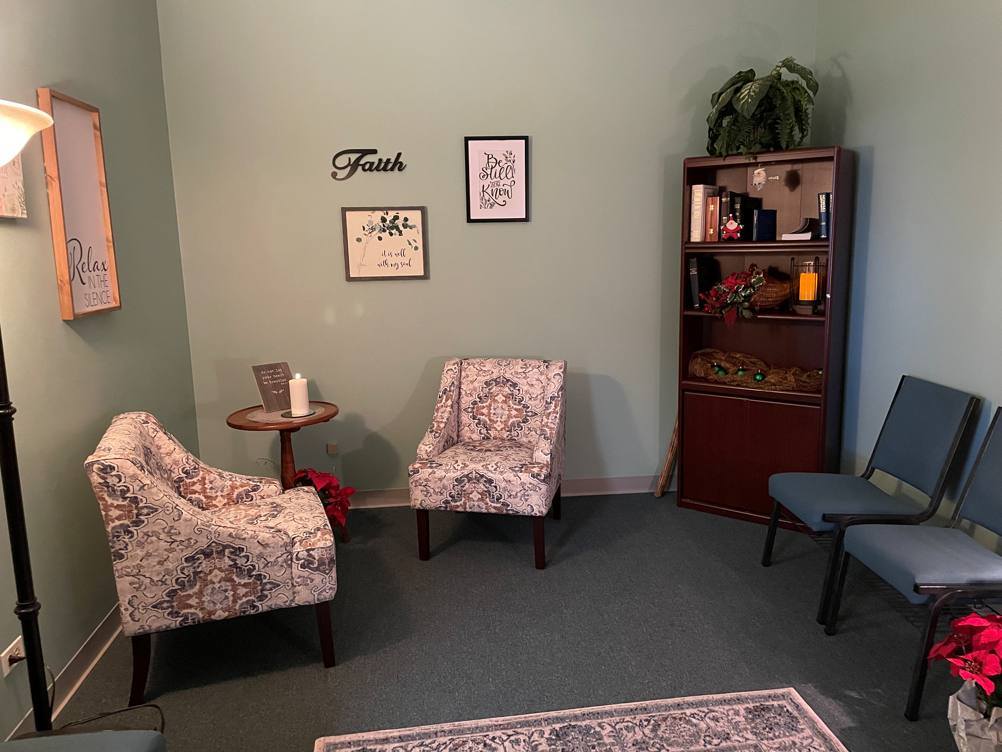
One-on-One
Prayer
with
Unity’s Chaplain
Email
prayer@unityinnaperville.org
with Name & Phone
to request a prayer call today by 1pm.

Slide 38
  For information
  on events go to:
  UnityInNaperville.org
  Questions? Email
  Admin@UnityInNaperville.org

Slide 40

Board of Trustees Elections
Apply now thru 3/23
Forms in the Café or email
RevKitty@unityinnaperville.org
Must be a Unity Member
Membership class on Sun Mar 23

Slide 41


SUN MAR 23
12 noon – 3pm at Unity
Email RevKitty@unityinnaperville.org to let her know you’re coming or if you’re interested in a Zoom class.
More info on our calendar at UnityInNaperville.org

Slide 42
Notes:
Beauty Slide

Slide 43

I’m Choosing Heaven
Rickie Byars Beckwith © 2001
I’m choosing heaven today
I’m choosing heaven today
I am walking the road
of heaven right now singing,
I’m choosing heaven today
love peace heaven

Slide 44
Notes:
Beauty Slide

Slide 45
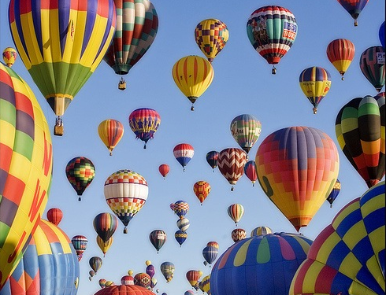
I’m not concerned.
Wonderful things
are happening!

Slide 46
Notes:
Beauty Slide

