Slide 1
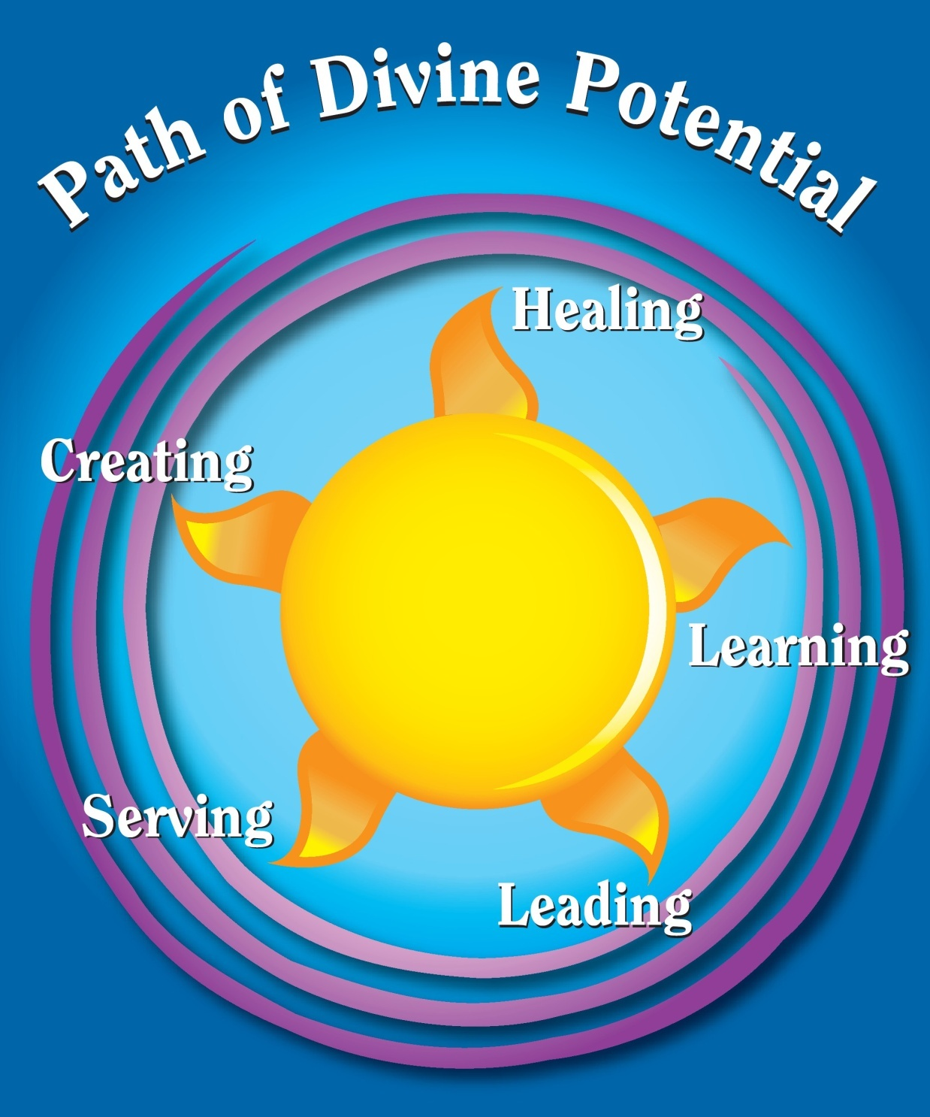

Slide 2
If your actions inspire others
to dream more, learn more,
do more and become more, you are a leader.
John Quincy Adams

Slide 3
A community is like a ship; everyone ought to be prepared to take the helm. Henrik Ibsen

Slide 4
We realize that we can best
serve those we love by setting
an example of right thought
and right conduct, and giving them the free opportunity to pattern their lives after us in
their own way. Harold Sherman

Slide 5
The greatest among you must become like the youngest, and the leader like one who serves. For who is greater, the one who is at the table or the one who serves? Is it not the one at the table? But I am among you as one who serves. Luke 22.26

Slide 6
Give and it will be given to you.
Luke 6.38
Today I learn the law of love;
that what I give my brother
is a gift to me.
A Course in Miracles Workbook

Slide 7
Truly I tell you, there is no one who has left house or brothers or sisters or mother or father or children or fields, for my sake and for the sake of the good news, who will not receive a hundredfold now, in this age. Mark 10.29

Slide 8
When we forget our own desires and devote ourselves to doing what God would have done, this moment and constantly, we shall find that there is no limit to the strength we have and the things we can do. We have yielded ourselves to the source and entered into a oneness that makes us receptive to all that the source is and holds for us. Myrtle Fillmore
Loving, self-forgetting service is the shortest, the safest, and the surest way to God.
Gardner Hunting

Slide 9
Make me an instrument,
Lord of your peace.
Where there is hatred
let me sow love
Where there is injury,
pardon
Where there is doubt,
faith
Where there is despair,
hope
Where there is darkness,
light
Where there is sadness,
joy

Slide 10
O Divine Master, grant that I may seek not so much to be consoled
as to console,
to be understood as to understand, to be loved, as to love.
For it is in giving that we receive, It is in pardoning that we are pardoned,
It is in dying to self that we are born to
eternal life.

Slide 11
We love you,
we bless you,
we appreciate you,
and we behold
the Christ
living as you.

Slide 12
I am generous with praise, gratitude and encouragement.

